Slide 1


Hardware
Teltonika Worker badge GH5200
Teltonika Eye beacon

Slide 2
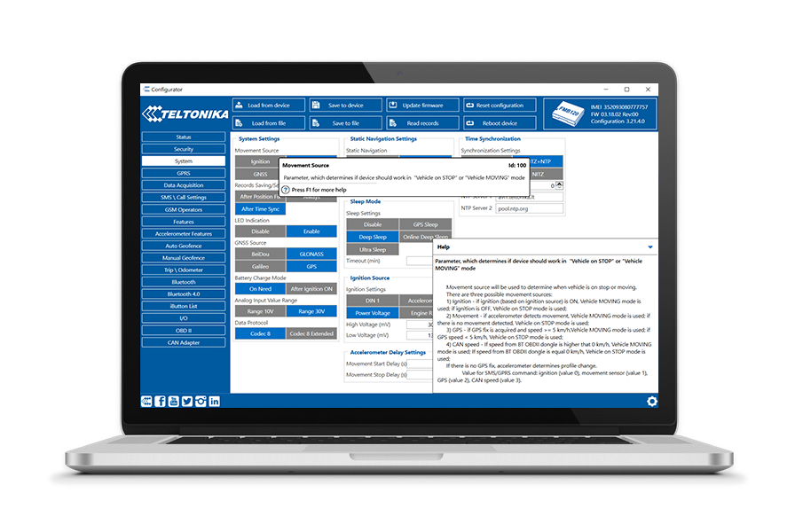
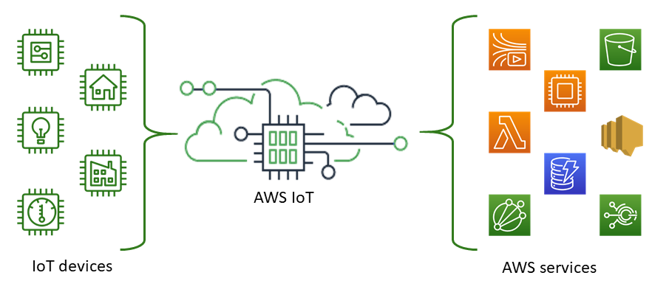
Software
Teltonika configurator
Flespi (optional)
AWS IOT (optional)
Flespi (optional)
Teltonika configurator
AWS IOT (optional)

Slide 3
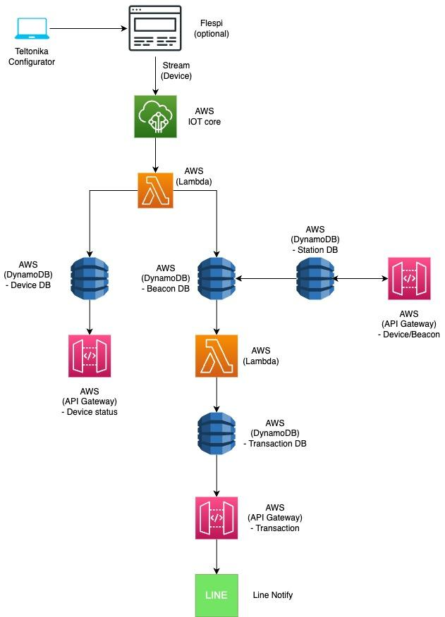
Configurature

Slide 4
Incoming message to AWS iot core
{
"battery_level": 100,
"battery_voltage": 4.131,
"channel_id": 1147671,
"custom_param_116": 1,
"device_id": 5046452,
"device_name": "rental HQ ",
"device_type_id": 507,
"event_priority_enum": 0,
"gnss_state_enum": 2,
"gnss_status": true,
"gsm_mcc": 520,
"gsm_mnc": 99,
"gsm_operator_code": "52099",
"gsm_signal_level": 60,
"ident": "350424060996137",
"movement_status": false,
"peer": "223.24.169.176:32738",
"position_altitude": 0,
"position_direction": 0,
"position_hdop": 0,
"position_pdop": 0,
"position_satellites": 0,
"position_speed": 0,
"position_valid": false,
"protocol_id": 14,
"server_timestamp": 1681973545.377987,
"sleep_mode_enum": 0,
"timestamp": 1681973540
}
{
"ble_beacons": [
{
"id": "E0702891-AE8E-8DC0-B0DE-3C666B326CA9:3138:0055",
"rssi": -45
},
{
"id": "FFFFFFFF-0D6C-CF10-48B9-55AAB8167ABB:F363:0055",
"rssi": -41
}
],
"channel_id": 1147671,
"device_id": 5046452,
"device_name": "rental HQ ",
"device_type_id": 507,
"event_enum": 385,
"event_priority_enum": 0,
"ident": "350424060996137",
"peer": "223.24.169.176:53929",
"position_altitude": 0,
"position_direction": 0,
"position_satellites": 0,
"position_speed": 0,
"protocol_id": 14,
"server_timestamp": 1681973660.969941,
"timestamp": 1681973631.001
}

Slide 5
Device DB
{
"battery_level": 100,
"battery_voltage": 4.131,
"channel_id": 1147671,
"custom_param_116": 1,
"device_id": 5046452,
"device_name": "rental HQ ",
"device_type_id": 507,
"event_priority_enum": 0,
"gnss_state_enum": 2,
"gnss_status": true,
"gsm_mcc": 520,
"gsm_mnc": 99,
"gsm_operator_code": "52099",
"gsm_signal_level": 60,
"ident": "350424060996137",
"movement_status": false,
"peer": "223.24.169.176:32738",
"position_altitude": 0,
"position_direction": 0,
"position_hdop": 0,
"position_pdop": 0,
"position_satellites": 0,
"position_speed": 0,
"position_valid": false,
"protocol_id": 14,
"server_timestamp": 1681973545.377987,
"sleep_mode_enum": 0,
"timestamp": 1681973540
}
device_id | timestamp | battery_level | battery_voltage | channel_id | device_name | device_type_id | event_priority_enum | gnss_state_enum | gnss_status | gsm_mcc | gsm_mnc | gsm_operator_code | gsm_signal_level | ident | movement_status | peer | position_altitude | position_direction | position_hdop | position_pdop | position_satellites | position_speed | position_valid | protocol_id | server_timestamp | sleep_mode_enum
5046452 | 1681807442 | 85 | 4 | 1147671 | "rental HQ " | 507 | 0 | 2 | TRUE | 520 | 99 | 52099 | 40 | 350424060996137 | FALSE | 223.24.188.144:23388 | 0 | 0 | 0 | 0 | 0 | 0 | FALSE | 14 | 1681807445.067990 | 0
5046452 | 1681878200 | 56 | 3.795 | 1147671 | "rental HQ " | 507 | 0 | 2 | TRUE | 520 | 99 | 52099 | 60 | 350424060996137 | FALSE | 223.24.93.134:62128 | 0 | 0 | 0 | 0 | 0 | 0 | FALSE | 14 | 1681878223.332310 | 0
5046452 | 1681879274 | 53 | 3.775 | 1147671 | "rental HQ " | 507 | 0 | 2 | TRUE | 520 | 99 | 52099 | 60 | 350424060996137 | FALSE | 223.24.93.134:31533 | 0 | 0 | 0 | 0 | 0 | 0 | FALSE | 14 | 1681879338.231900 | 0

Slide 6
Beacon DB
beacon_id | timestamp | device_id | is_present | rssi
E0702891-AE8E-8DC0-B0DE-3C666B326CA9:3138:0055 | 1681961286.001 | 5046452 | TRUE | '-36
E0702891-AE8E-8DC0-B0DE-3C666B326CA9:3138:0055 | 1681961395.001 | 5046452 | TRUE | '-37
FFFFFFFF-0D6C-CF10-48B9-55AAB8167ABB:F363:0055 | 1681962503.001 | 5046452 | TRUE | '-50
E0702891-AE8E-8DC0-B0DE-3C666B326CA9:3138:0055 | 1681962749.001 | 5046452 | TRUE | '-39
E0702891-AE8E-8DC0-B0DE-3C666B326CA9:3138:0055 | 1681962503.001 | 5046452 | TRUE | '-39
FFFFFFFF-0D6C-CF10-48B9-55AAB8167ABB:F363:0055 | 1681962620.001 | 5046452 | TRUE | '-48
E0702891-AE8E-8DC0-B0DE-3C666B326CA9:3138:0055 | 1681962620.001 | 5046452 | TRUE | '-38
FFFFFFFF-0D6C-CF10-48B9-55AAB8167ABB:F363:0055 | 1681962749.001 | 5046452 | TRUE | '-52
{
"ble_beacons": [
{
"id": "E0702891-AE8E-8DC0-B0DE-3C666B326CA9:3138:0055",
"rssi": -45
},
{
"id": "FFFFFFFF-0D6C-CF10-48B9-55AAB8167ABB:F363:0055",
"rssi": -41
}
],
"channel_id": 1147671,
"device_id": 5046452,
"device_name": "rental HQ ",
"device_type_id": 507,
"event_enum": 385,
"event_priority_enum": 0,
"ident": "350424060996137",
"peer": "223.24.169.176:53929",
"position_altitude": 0,
"position_direction": 0,
"position_satellites": 0,
"position_speed": 0,
"protocol_id": 14,
"server_timestamp": 1681973660.969941,
"timestamp": 1681973631.001
}
Rssi > -70 ; is_present = True
Rssi < -70 : is_present = False
If not found beacon > 2 min
: is_present = False
Check every ble_beacon will loop every beacon in device, if not found : is_present = False

Slide 7
Station DB
device_id | beacon_list
5046452 | [{"S":"E0702891-AE8E-8DC0-B0DE-3C666B326CA9:3138:0055"},{"S":"FFFFFFFF-0D6C-CF10-48B9-55AAB8167ABB:F363:0055"}]
5046451 | [{"S":"E0702891-AE8E-8DC0-B0DE-3C666B326CA9:3138:0055"},{"S":"FFFFFFFF-0D6C-CF10-48B9-55AAB8167ABB:F363:0055"}]
5046453 | [{"S":"E0702891-AE8E-8DC0-B0DE-3C666B326CA9:3138:0055"},{"S":"FFFFFFFF-0D6C-CF10-48B9-55AAB8167ABB:F363:0055"}]
5046454 | [{"S":"E0702891-AE8E-8DC0-B0DE-3C666B326CA9:3138:0055"},{"S":"FFFFFFFF-0D6C-CF10-48B9-55AAB8167ABB:F363:0055"}]
5046455 | [{"S":"E0702891-AE8E-8DC0-B0DE-3C666B326CA9:3138:0055"},{"S":"FFFFFFFF-0D6C-CF10-48B9-55AAB8167ABB:F363:0055"}]
5046456 | [{"S":"E0702891-AE8E-8DC0-B0DE-3C666B326CA9:3138:0055"},{"S":"FFFFFFFF-0D6C-CF10-48B9-55AAB8167ABB:F363:0055"}]
5046457 | [{"S":"E0702891-AE8E-8DC0-B0DE-3C666B326CA9:3138:0055"},{"S":"FFFFFFFF-0D6C-CF10-48B9-55AAB8167ABB:F363:0055"}]

Slide 8
Transaction DB
txn_id | timestamp | device_id | beacon_id | starttime | endtime | duration | status
txn-23040001 | 2023-04-20 10:00:00 | d1 | b1 | 2023-04-20 10:00:00 | 2023-04-20 11:00:00 | 1:00:00 | completed
txn-23040002 | 2023-04-20 11:00:00 | d1 | b2 | 2023-04-20 11:00:00 | 2023-04-20 14:38:41 | 3:38:41 | ongoing
txn-23040003 | 2023-04-20 11:30:00 | d2 | b3 | 2023-04-20 11:30:00 | 2023-04-20 12:00:00 | 0:30:00 | completed
txn-23040004 | 2023-04-20 12:00:00 | d3 | b4 | 2023-04-20 12:00:00 | 2023-04-20 14:00:00 | 2:00:00 | completed
txn-23040005 | 2023-04-20 12:30:00 | d1 | b1 | 2023-04-20 12:30:00 | 2023-04-20 14:38:41 | 2:08:41 | ongoing
txn-23040006 | 2023-04-20 13:15:00 | d3 | b5 | 2023-04-20 13:15:00 | 2023-04-21 7:00:00 | 17:45:00 | completed
txn-23040007 | 2023-04-20 14:00:00 | d1 | b1 | 2023-04-20 14:00:00 | 2023-04-21 11:00:00 | 21:00:00 | completed
txn-23040008 | 2023-04-20 14:30:00 | d2 | b3 | 2023-04-20 14:30:00 | 2023-04-20 14:35:00 | 0:05:00 | completed
Beacon_status (is_present) | Transaction status (status) | Start
TRUE | completed | X
1st FALSE | completed | X
2nd FALSE | completed | Yes
Starttime = 1st false
Endtime = 1st true
Duration = Endtime - Starttime
Status:
is_present = True > completed
Is_present = False > ongoing
Beacon_status (is_present) | Transaction status (status) | Stop
FALSE | ongoing | X
TRUE | ongoing | Yes

Slide 9
Status Report
Station | Battery | Movement | Beacon | Status
S1 (device1) | 100 | No | b1 | Available
 |  |  | b2 | Ongoing
 |  |  | b3 | Available
 |  |  | b4 | Available
 |  |  | b5 | Ongoing
S2 (device2) | 80 | No | b6 | Available
 |  |  | b7 | Ongoing
 |  |  | b8 | Available
S3 (device3) | 20 | Yes | b9 | Ongoing
 |  |  | b10 | Available
 |  |  | b11 | Available
 |  |  | b12 | Ongoing
Repair Center |  |  | b13 | -
 |  |  | b14 | -
 |  |  | b15 | -
Requirement
Adjust Station-Beacon
API gateway
Alert to line notify when
Battery < 20
Movement is Yes

Slide 10
Transaction Report
txn_id | timestamp | device_id | beacon_id | starttime | endtime | duration | status
txn-23040001 | 2023-04-20 10:00:00 | d1 | b1 | 2023-04-20 10:00:00 | 2023-04-20 11:00:00 | 1:00:00 | completed
txn-23040002 | 2023-04-20 11:00:00 | d1 | b2 | 2023-04-20 11:00:00 | 2023-04-20 14:38:41 | 3:38:41 | ongoing
txn-23040003 | 2023-04-20 11:30:00 | d2 | b3 | 2023-04-20 11:30:00 | 2023-04-20 12:00:00 | 0:30:00 | completed
txn-23040004 | 2023-04-20 12:00:00 | d3 | b4 | 2023-04-20 12:00:00 | 2023-04-20 14:00:00 | 2:00:00 | completed
txn-23040005 | 2023-04-20 12:30:00 | d1 | b1 | 2023-04-20 12:30:00 | 2023-04-20 14:38:41 | 2:08:41 | ongoing
txn-23040006 | 2023-04-20 13:15:00 | d3 | b5 | 2023-04-20 13:15:00 | 2023-04-21 7:00:00 | 17:45:00 | completed
txn-23040007 | 2023-04-20 14:00:00 | d1 | b1 | 2023-04-20 14:00:00 | 2023-04-21 11:00:00 | 21:00:00 | completed
txn-23040008 | 2023-04-20 14:30:00 | d2 | b3 | 2023-04-20 14:30:00 | 2023-04-20 14:35:00 | 0:05:00 | completed
Requirement
API gateway
Alert to line notify when
When create transaction > inform
When stop transaction > inform

